Slide 1

Using the power of data science for real-time spatial and temporal visualization and modeling of COVID-19
Rachel Moss Carroll, Ph.D.
Assistant Professor of Statistics and Data Science
Department of Mathematics and Statistics
University of North Carolina Wilmington
Notes:
Thank you for the opportunity and invitation to speak in this context
This presentation is for an on going project related to COVID-19
I began looking into data involving the COVID-19 crisis in early March 2020. Understanding how the disease spreads has become vital in efforts to suppress it. Widely accessible data has furnished a unique opportunity for me to explore data visualizations and statistical methods in real-time for a purpose of making this analysis accessible to the general public.

Slide 2
COVID-19 Background
Began in Wuhan, China in December of 2019 and quickly evolved into a global crisis
As of May 18, 2020 in the United States
1,492,822 confirmed cases
89,101 deaths
This project involves:
Data mining and compilation
Development of data visualization dashboards
Statistical modeling
Notes:
Most of this is not necessarily needed for this audience…
Data was pulled from many different sources for this project
These were this initial step in this project and the most useful for public dissemination…there are links throughout this presentation that take you to many of the related dashboards…this particular link takes you to the UNCW data science page (no click)
Traditional disease mapping techniques were used here. More on this to come.

Slide 3
Data
Outcomes: Johns Hopkins University Center for Systems Science and Engineering
Confirmed cases, active cases, new cases, and deaths in the U.S.
Predictors:
Presence of an international airport (yes vs. no)
Day of week (early vs. late)
Presence of a state-issued stay at home order (before, during – partial, during – full, and none)
Continuous population characteristics represented as a percent of the population: Unemployed, smoker, aged >=65, African American
Notes:
Others have mentioned several negative things wrt the JHU data. However, I began this journey looking at international trends in COVID19, so to keep consistency across dashboards, we continued to work with this data source.
For those interested, this variable was quite difficult to source. I had to combine information from multiple sources with airport codes then use lat/longs to id what spatial area the airport resided
There is evidence that more cases are generally reported later in the week (I think this is a US only trend)...click link
Stay at home orders were issued in the us on a state level basis. This variable was constructed by hand and required examination of official government documents. A NY times article compiled some of this information but it wasn’t quite enough
Census bureau information 5 year estimates 2014-2019 (except unemployment was a march 2020 estimate)…things that others have mentioned as important to consider

Slide 4
Data
Spatial unit: Health Regions
Definition - One or more counties serviced by the same health department
Justification:
Zero count of confirmed cases (as of May 18, 2020): 33,206 (U.S. county) to 302 (U.S. Health Region)
Spatial dimension: 3,142 (number of U.S. counties) to 389 (number of U.S. Health Regions)
Temporal Unit: Days
Limited to the first 8 weeks of recorded data (March 23, 2020 to May 18, 2020)
Notes:
While this data is available at the county level, including all of this information becomes quite computationally intense when fitting across the US and there were many 0’s (even for confirmed cases) at the county level.
The temporal unit was an easy decision since that’s what is available and appeared most appropriate
Limiting to the first eight weeks was necessary and appropriate for two reasons:
to guarantee good representation in the two temporal varying predictors (several states had moved to partial sah by this time and had been there for at least 2 weeks)
will allow for comparison between our predictions and the actual reported data (not quite finished work)

Slide 5
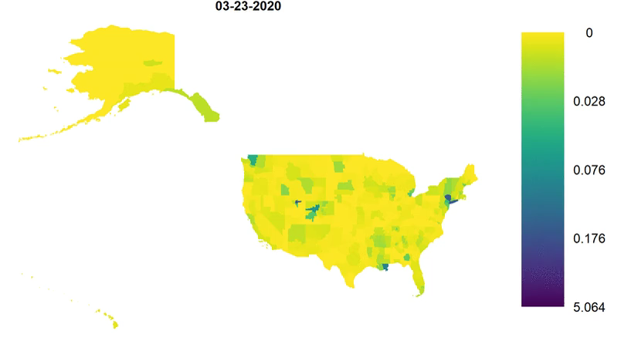
Data – Confirmed Cases
Notes:
This is confirmed cases as a percent of the population at the Health Region level
You can see the hot spots across the country
The area in the n/mid west remains lighter…very rural
Hot spots: Washington, Louisiana, NYC/northeast, Miami, northern parts of NM and AZ…much of the deep south and Atlantic coast
CA was one of the first to shutdown and seems to have been one of the most stringent wrt reopening and that appears to pay off
E.g. Mardi Gras in LA
The distns of active cases and deaths are very similar as you might expect…this hyperlink takes you to a dashboard that displays this information at the county level (no click)

Slide 6
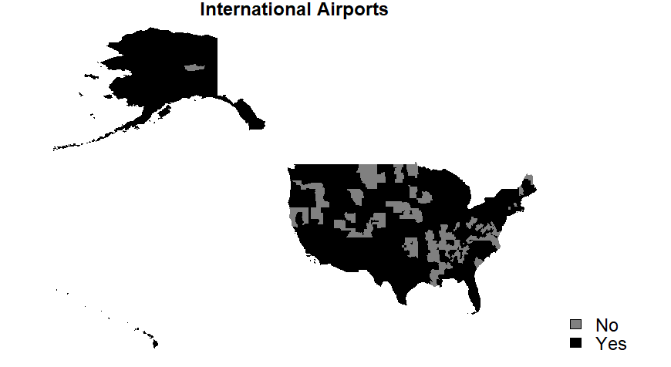
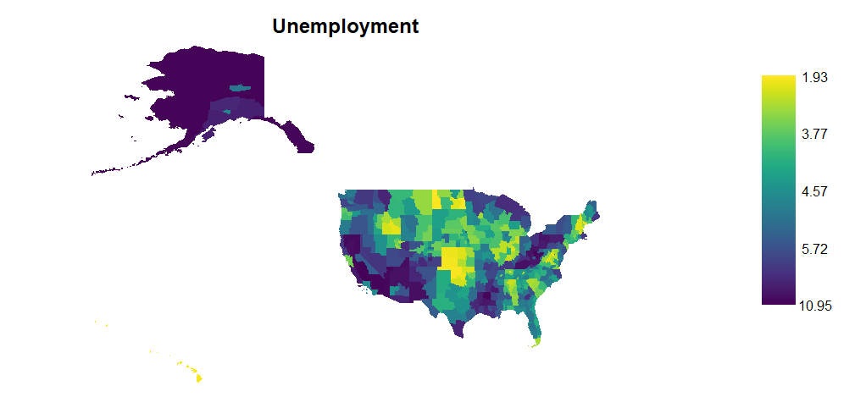
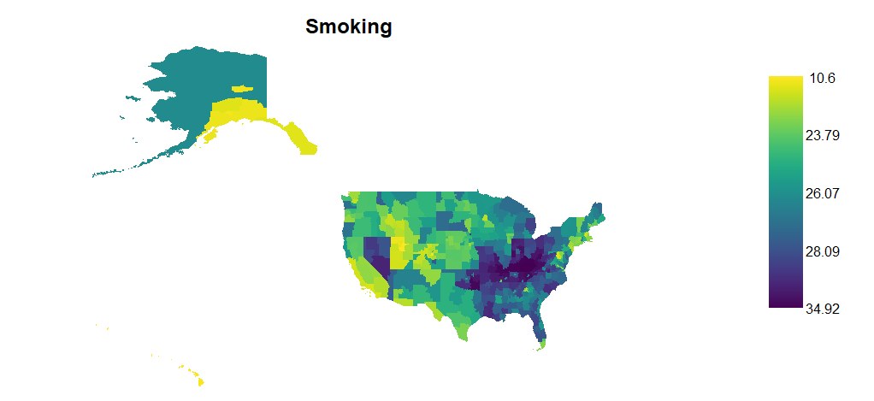
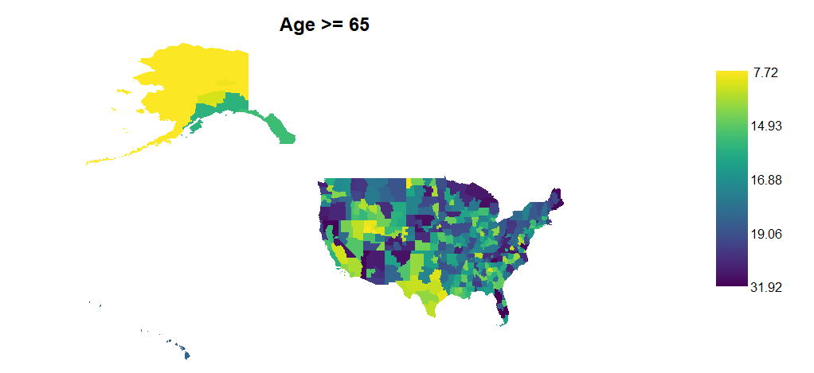
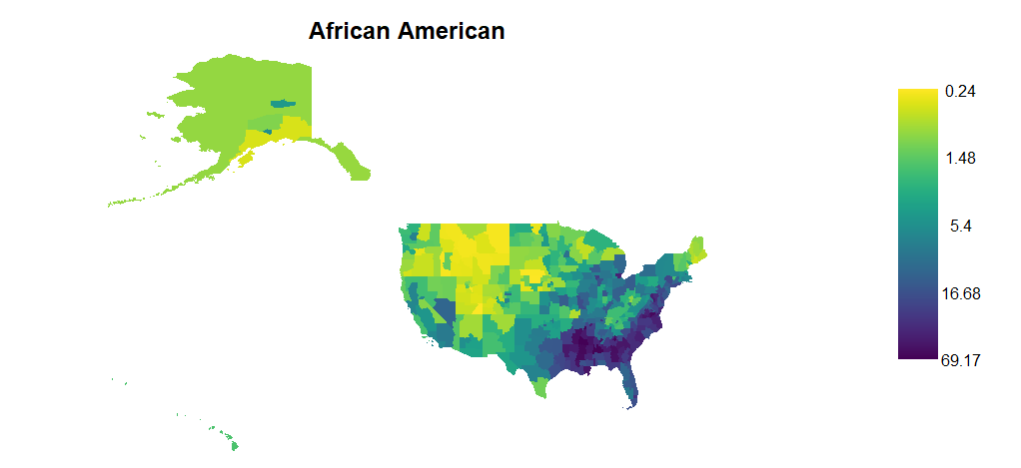
Data – Spatial Predictors
Notes:
There is some clear spatial structuring in these variables
Int airports is much of the country. I played around a little with cut offs for how big of a airport to consider and a representation of the number of international passengers but this is where I settled
Unemployment is a march 2020 estimate of unemployment. We see large amounts of this in the western part of the country and in Louisiana (hot spot reminder)
Smoking is generally clustered in what’s referred to as the “diabetes belt” which carves its way through much of the southeastern part of the country…and Utah
Age is probably the least spatially structured. This has higher areas in FL, OR, AZ, and a couple areas in the north

Slide 7
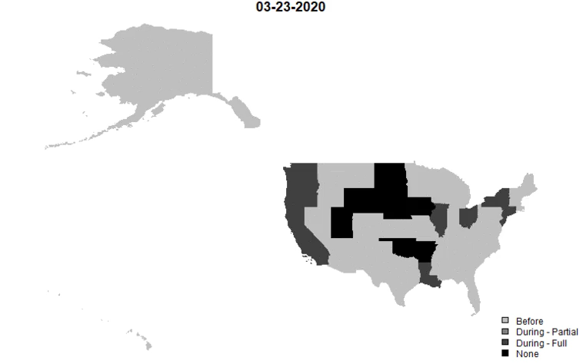
Data – Stay at Home
Notes:
Depending on the resolution of your screen, the darker colors may be difficult to distinguish
Several states never issued a state-wide SAH order – Arkansas, Iowa, Nebraska, North Dakota, Oklahoma, South Dakota, Utah, and Wyoming
Several states SAH at the start – CA, CT, IL, LA, NJ, NY, OH, OR, WA
You can see the country close down and then begin to reopen (partially) during the window that we’re examining here
AK is now fully open but was not on may 18…I have added an after category to capture this in the real time tracking.

Slide 8

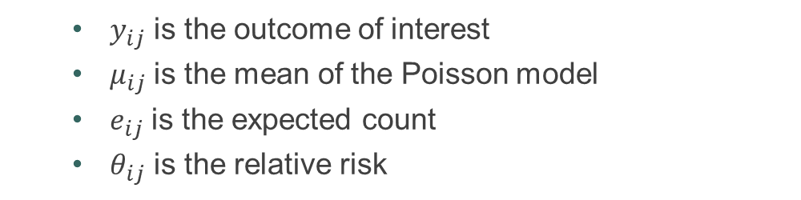
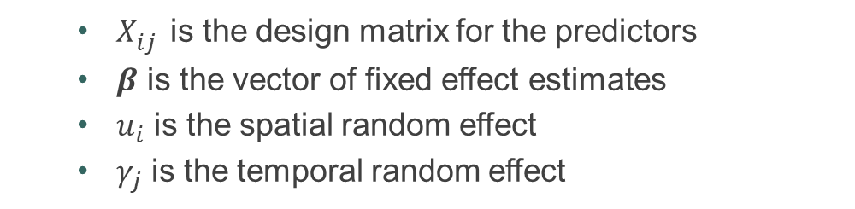
Statistical Model
For Health Region $i$ and day $j$:
$$y_{ij}\sim Pois\left(μ_{ij}\right)$$
$$μ_{ij}=e_{ij}θ_{ij}$$
$$\log\left(θ_{ij}\right)= X_{ij}^{′}β+u_{i}+γ_{j}$$
where
$y_{ij}$ is the outcome of interest
$μ_{ij}$ is the mean of the Poisson model
$e_{ij}$ is the expected count
$θ_{ij}$ is the relative risk
$X_{ij}^{}$ is the design matrix for the predictors
$β$ is the vector of fixed effect estimates
$u_{i}$ is the spatial random effect
$γ_{j}$ is the temporal random effect
Notes:
This is a traditional Bayesian disease mapping model for aggregated count data.
$e_{ij}$ is calculated as the rate of infection over all regions times the population at risk for a given health region.

Slide 9
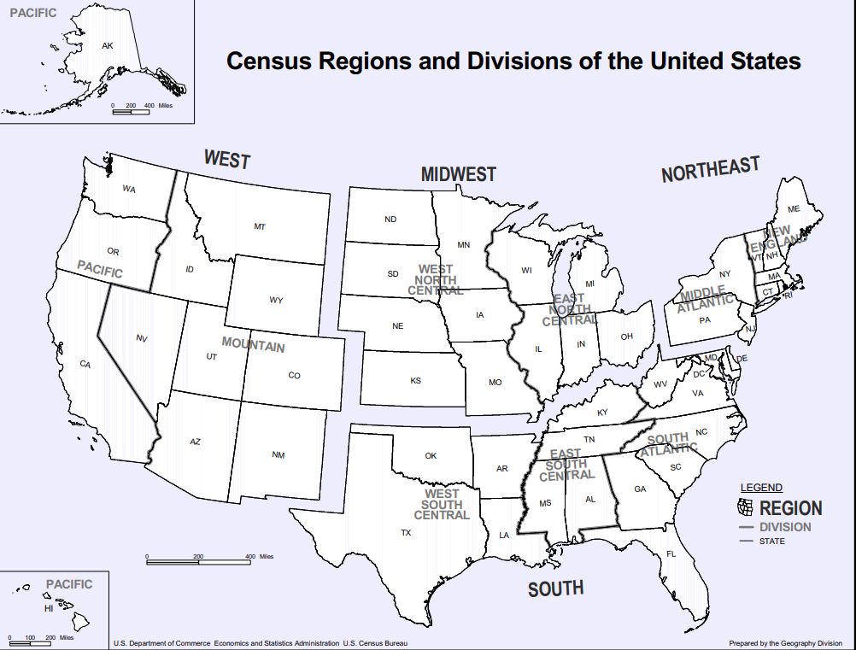
Notes:
This model was performed for the US as a whole as well as individually for the census-defined regions – S, W, MD, NE
So, 4 outcomes (confirmed, active, new, and deaths) and 5 spatial restrictions on the data lead to 20 models.

Slide 10
Computational Details
Data processing, statistical modeling, and plotting
R statistical software – rgdal, INLA, fillmap, and shiny
Data visualization
R-shiny
Tableau
Power BI
Notes:
R statistical software furnished much the means for data processing and analysis in this work.
Data visualization dashboards with an array of popular software
In addition to the regression model results, these dashboards also display general spatial, temporal, and spatio-temporal tracking of COVID-19 cases and deaths at the county, state, national, and international levels.

Slide 11
Results – Statistical Modeling
(click the link)
Notes:
Use the south with confirmed cases as an example
Increased risk for confirmed cases during partial SAHO vs. before….governments potentially moved to partial too soon or made the decision that the curve had been flattened enough and their healthcare system could handle the increase in patients
Decreased risk for confirmed cases during full SAHO vs. before…SAHO does offer protection
Decrease risk of confirmed cases for states with no SAHO…these governments made an appropriate decision about their need for a SAHO
Less risk as % unemployed increases -> less social interaction with less going to work
More risk as % AA increases -> confirms statements that minority areas were impacted more…the south is a good place to examine this because of the better representation of minority (African American) population
Spatial residual shows differences in risk after adjusting for the predictors.
This indicates less risk in TX, more in FL.
You see a strong state-level signature here.
Notice that the risk in LA is largely explained by the predictors. I find that very interesting.
Temporal residual shows trends over time
We don’t see a day of the week signature here. It was accounted for in the predictor and in eij
There is a peak at day 33. This is April 24…the day that GA reopened, a few days after SC reopened, but we shouldn’t see an effect of it that soon.

Slide 12
General Highlights of Results
Less risk under full stay at home orders
Varied risk under partial stay at home orders
Less risk with more unemployment
More risk with higher African American population in the south
Less risk of new cases, but higher risk of death with more older population
Notes:
The estimates depend on the outcome, region, and day of the outbreak considered. These are not 100% consistent across models…

Slide 13
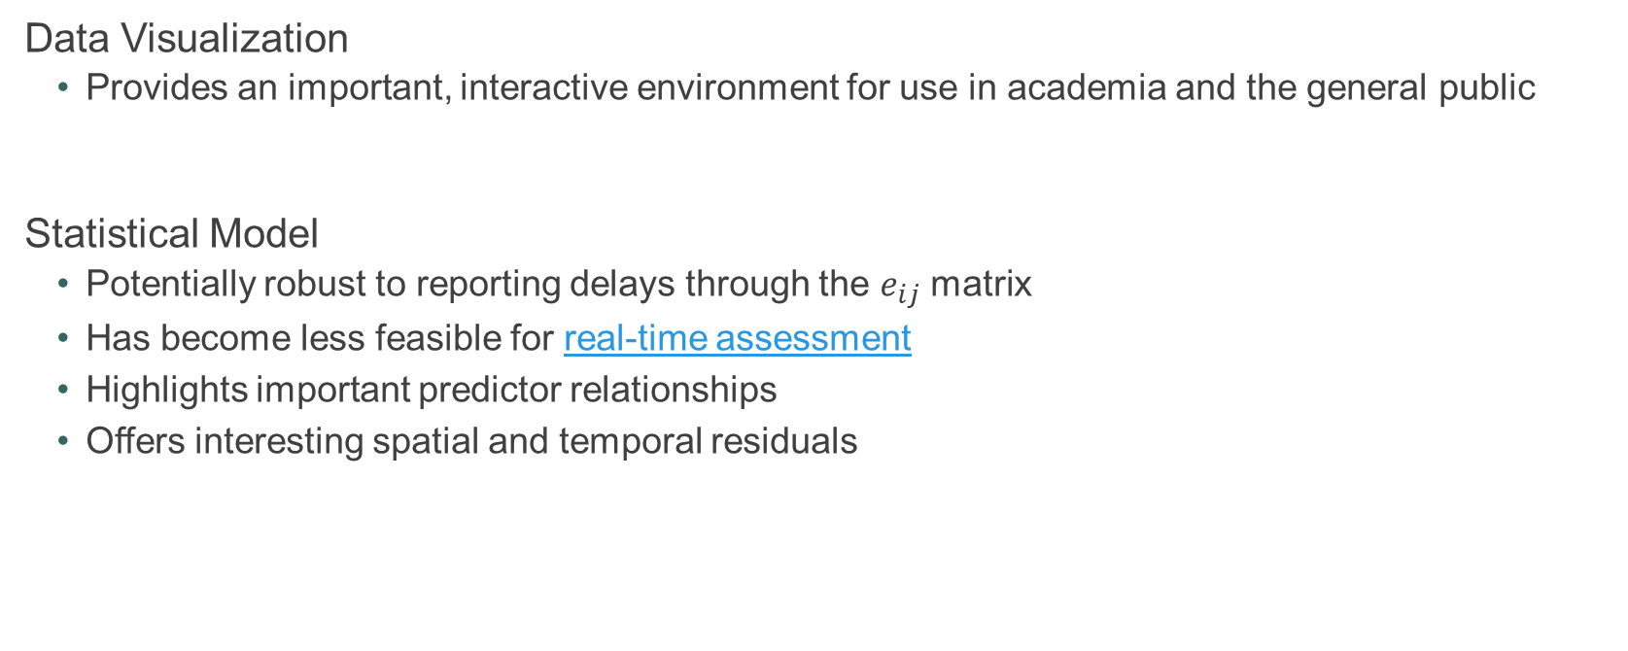
Conclusions
Data Visualization
Provides an important, interactive environment for use in academia and the general public
Statistical Model
Potentially robust to reporting delays through the $e_{ij}$ matrix
Has become less feasible for real-time assessment
Highlights important predictor relationships
Offers interesting spatial and temporal residuals

Slide 14
Future directions
Predictive modeling
Temporally dependent coefficients
Notes:
A colleague has a model for creating predictions from the spatial residuals. We plan to build on this model by comparing predictions to observed data.
I think that there could be a relationship over time wrt the covariates. For example, I think that international airports could be more important at the beginning of outbreak vs. the end.

Slide 15
Questions?
This work was sponsored in part by the UNCW Center for Social Impact
Collaborative work by: UNCW M.S. Data Science Students, Mark Lammers, Zachary Williams, and Dylan McNamara
Additional public dissemination efforts by New Hanover’s Cape Fear Collective
Link to my GitHub

Slide 16
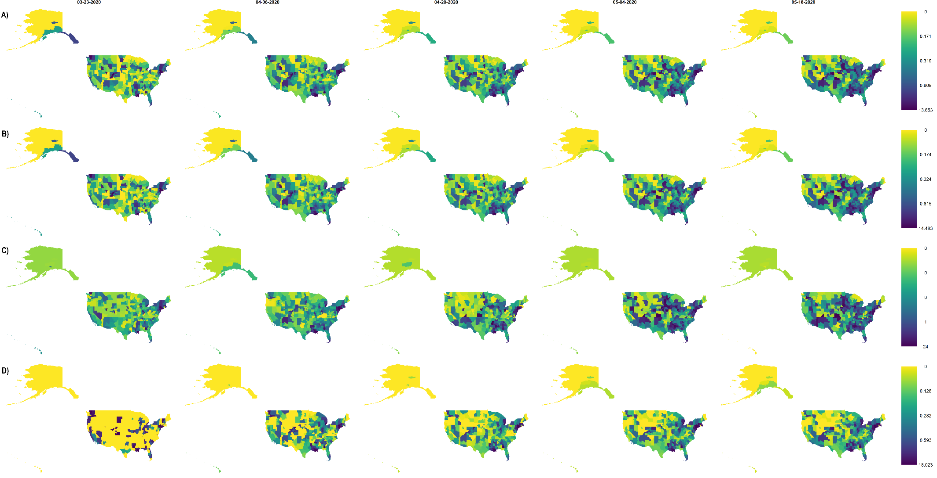
Results – Outcome SIR/SMR
Confirmed
cases
Active
cases
New
cases
Deaths
Notes:
SIR/SMR is the observed count over the expected count (yij/eij)
I know that this is a really large figure, but my main take away here, across outcomes is that the spatial distn of sir/smr is largely the same across time indicating that there may not be a need for a space/time interaction term
Deaths and new cases less consistent.

